Slide 1
Chapter 5: CPU Scheduling

Slide 2
Scheduling Criteria
CPU utilization – keep the CPU as busy as possible
Throughput – # of processes that complete their execution per time unit
Turnaround time – amount of time to execute a particular process
Waiting time – amount of time a process has been waiting in the ready queue
Response time – amount of time it takes from when a request was submitted until the first response is produced, not output (for time-sharing environment)

Slide 3
Scheduling Algorithm Optimization Criteria
Max CPU utilization
Max throughput
Min turnaround time
Min waiting time
Min response time
Turnaround Time= Completion Time- Arrival Time
Waiting Time= Turnaround Time- Burst Time

Slide 4
First-Come, First-Served (FCFS) Scheduling
Non preemptive Type of Scheduling
Process Burst Time
P₁ 24
P₂ 3
P₃ 3
Suppose that the processes arrive in the order: P₁ , P₂ , P₃
The Gantt Chart for the schedule is:
P₁
P₂
P₃
0
24
27
30

Slide 5
First-Come, First-Served (FCFS) Scheduling
Waiting time for P₁ = 0; P₂ = 24; P₃ = 27
Average waiting time: (0 + 24 + 27)/3 = 17
Process No | Arrival Time | Burst Time | Completion Time | Turnaround Time= (CT-AT) | Waiting Time=(TAT-BT)
P1 | 0 | 24 | 24 | 24 | 0
P2 | 0 | 3 | 27 | 27 | 24
P3 | 0 | 3 | 30 | 30 | 27
AVG |  |  |  | 27 | 17

Slide 6
FCFS Scheduling (Cont.)
Suppose that the processes arrive in the order:
P₂ , P₃ , P₁
The Gantt chart for the schedule is:
P₂
P₃
P₁
0
3
6
30

Slide 7
FCFS Scheduling (Cont.)
Process No | Arrival Time | Burst Time | Completion Time | Turnaround Time= (CT-AT) | Waiting Time=(TAT-BT)
P2 | 0 | 3 | 3 | 3 | 0
P3 | 0 | 3 | 6 | 6 | 3
P1 | 0 | 24 | 30 | 30 | 6
AVG |  |  |  | 13 | 3
Waiting time for P₁ = 6; P₂ = 0; P₃ = 3
Average waiting time: (6 + 0 + 3)/3 = 3
Much better than previous case

Slide 8
First-Come, First-Served (FCFS) Scheduling
Apply FCFS CPU Scheduling algorithm on the following. Calculate Average turn around time and average waiting time.
Process | Arrival Time | Burst Time
1 | 0 | 4
2 | 1 | 3
3 | 2 | 1
4 | 3 | 2
5 | 4 | 5
P1 | P2 | P3 | P4 | P5
0
4
7
8
10
15

Slide 9
FCFS Scheduling (Cont.)
Process No | Arrival Time | Burst Time | Completion Time | Turnaround Time= (CT-AT) | Waiting Time=(TAT-BT)
P1 | 0 | 4 | 4 | 4 | 0
P2 | 1 | 3 | 7 | 6 | 3
P3 | 2 | 1 | 8 | 6 | 5
P4 | 3 | 2 | 10 | 7 | 5
P5 | 4 | 5 | 15 | 11 | 6
AVG |  |  |  | 6.8 | 3.8
Average waiting time: 3.8
Average Turn Around Time: 6.8

Slide 10
Exercise
Apply FCFS CPU Scheduling algorithm on the following. Calculate Average turn around time and average waiting time.
Process | Arrival Time | Burst Time
1 | 0 | 2
2 | 3 | 1
3 | 5 | 6
P1 |  | P2 |  | P3
0
2
3
4
5
11

Slide 11
FCFS Scheduling (Cont.)
Process No | Arrival Time | Burst Time | Completion Time | Turnaround Time= (CT-AT) | Waiting Time=(TAT-BT)
P1 | 0 | 2 | 2 | 2 | 0
P2 | 3 | 1 | 4 | 1 | 0
P3 | 5 | 6 | 11 | 6 | 0
AVG |  |  |  | 3 | 0

Slide 12
FCFS Scheduling (Cont.)
Advantages of FCFS
The simplest form of a CPU scheduling algorithm
Easy to program
Disadvantages of FCFS
It is a Non-Preemptive CPU scheduling algorithm, so after the process has been allocated to the CPU, it will never release the CPU until it finishes executing. Therefore, Suffers from CONVOY effect.
The Average Waiting Time is high.
Short processes that are at the back of the queue have to wait for the long process at the front to finish.
Not an ideal technique for time-sharing systems.
Because of its simplicity, FCFS is not very efficient.

Slide 13
Shortest-Job-First (SJF) Scheduling
Non Preemptive
Associate with each process the length of its next CPU burst. Use these lengths to schedule the process with the shortest time.
SJF is optimal – gives minimum average waiting time for a given set of processes
The difficulty is knowing the length of the next CPU request.

Slide 14
Example of SJF (Non Preemptive)
Process Arrival Time Burst Time
P₁ 0.0 6
P₂ 2.0 8
P₃ 4.0 7
P₄ 5.0 3
SJF scheduling chart
Average waiting time = (3 + 16 + 9 + 0) / 4 = 7
P₄
P₁
P₃
P₂
0
3
9
16
24

Slide 15
Example of SJF- Non Preemptive
Apply SJF Non preemptive CPU Scheduling algorithm on the following. Calculate Average turn around time and average waiting time.
Process | Arrival Time | Burst Time
1 | 1 | 7
2 | 2 | 5
3 | 3 | 1
4 | 4 | 2
5 | 5 | 8
 | P1 | P3 | P4 | P2 | P5
0
1
8
9
11
16
24

Slide 16
Example of SJF- Non Preemptive(Cont.)
Process No | Arrival Time | Burst Time | Completion Time | Turnaround Time= (CT-AT) | Waiting Time=(TAT-BT)
P1 | 1 | 7 | 8 | 7 | 0
P2 | 2 | 5 | 16 | 14 | 9
P3 | 3 | 1 | 9 | 6 | 5
P4 | 4 | 2 | 11 | 7 | 5
P5 | 5 | 8 | 24 | 19 | 11
AVG |  |  |  | 10.6 | 6

Slide 17
Determining Length of Next CPU Burst
Can only estimate the length
Can be done by using the length of previous CPU bursts, using exponential averaging
τ _{n+1} = α t _{n} + (1- α) τ _{n}.

Slide 18
Shortest-Remaining- Time- First (SRTF/SRTN) Scheduling
It is Preemptive SJF.
It is faster in execution

Slide 19
Shortest-Remaining- Time- First (SRTF/SRTN) Scheduling Example
Calculate waiting time of P2 using SRTF process scheduling algorithm.
Process | Arrival Time | Burst Time
1 | 0 | 20
2 | 15 | 25
3 | 30 | 10
4 | 45 | 15
P1 | P1 | P2 | P3 | P2 | P2 | P4
0
15
20
30
40
45
55
70

Slide 20
Shortest-Remaining- Time- First (SRTF/SRTN) Scheduling Example
Process No | Arrival Time | Burst Time | Completion Time | Turnaround Time= (CT-AT) | Waiting Time=(TAT-BT)
P1 | 0 | 20 | 20 | 20 | 0
P2 | 15 | 25 | 55 | 40 | 15
P3 | 30 | 10 | 40 | 10 | 0
P4 | 45 | 15 | 70 | 25 | 10

Slide 21
Shortest-Remaining- Time- First (SRTF/SRTN) Scheduling Example
Apply SJF preemptive algorithm on the following processes and calculate AWT and ATAT.
Process | Arrival Time | Burst Time
P1 | 0 | 18
P2 | 1 | 4
P3 | 2 | 7
P4 | 3 | 2
P1 | P2 | P2 | P2 | P4 | P3 | P1
0
1
2
3
5
7
14
31

Slide 22
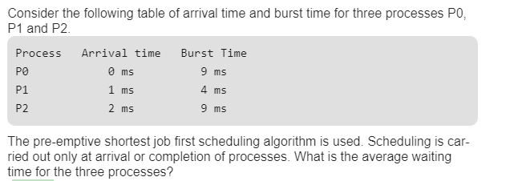
Shortest-Remaining- Time- First (SRTF/SRTN) Scheduling Example
Gate Question
P0 | P1 | P1 | P0 | P2
0
1
2
5
13
22

Slide 23
Shortest-Remaining- Time- First (SRTF/SRTN) Scheduling Example
Process No | Arrival Time | Burst Time | Completion Time | Turnaround Time= (CT-AT) | Waiting Time=(TAT-BT)
P0 | 0 | 9 | 13 | 13 | 4
P1 | 1 | 4 | 5 | 4 | 0
P2 | 2 | 9 | 22 | 20 | 11
AVG |  |  |  | 12.33 | 5

Slide 24
Shortest-Remaining- Time- First (SRTF/SRTN) Scheduling
Both SJF and SRTF are practically not feasible as it is not possible to predict the burst time of the processes.
Both SJF and SRTF may lead to process starvation as long processes may be held off indefinitely if short processes are continually added.

Slide 25
Priority Scheduling
A priority number (integer) is associated with each process
The CPU is allocated to the process with the highest priority (smallest integer ≡ highest priority)
Preemptive
Non-preemptive
Problem ≡ Starvation – low priority processes may never execute
Solution ≡ Aging – as time progresses increase the priority of the process

Slide 26
Non Preemptive Priority Scheduling Example
Apply non preemptive priority algorithm on the following processes and calculate WT, TAT and response time of each process..
Process | Priority | Arrival Time | Burst Time
P1 | 2 (L) | 0 | 4
P2 | 4 | 1 | 2
P3 | 6 | 2 | 3
P4 | 10 | 3 | 5
P5 | 8 | 4 | 1
P6 | 12 (H) | 5 | 4
P7 | 9 | 6 | 6
P1 | P4 | P6 | P7 | P5 | P3 | P2
0
4
9
13
19
20
23
25

Slide 27
Example of Priority- Non Preemptive(Cont.)
Process No | Priority | Arrival Time | Burst Time | Completion Time | Turnaround Time= (CT-AT) | Waiting Time=(TAT-BT) | Response Time
P1 | 2 (L) | 0 | 4 | 4 | 4 | 0 | 0
P2 | 4 | 1 | 2 | 25 | 24 | 22 | 22
P3 | 6 | 2 | 3 | 23 | 21 | 18 | 18
P4 | 10 | 3 | 5 | 9 | 6 | 1 | 1
P5 | 8 | 4 | 1 | 20 | 16 | 15 | 15
P6 | 12 (H) | 5 | 4 | 13 | 8 | 4 | 4
P7 | 9 | 6 | 6 | 19 | 13 | 7 | 7
Response time= AT- Time at which process is scheduled
RT= WT in case of nonpremptive algorithm

Slide 28
Preemptive Priority Scheduling Example
Apply preemptive priority algorithm on the following processes and calculate WT, TAT and response time of each process..
Process | Priority | Arrival Time | Burst Time
P1 | 2 (L) | 0 | 4
P2 | 4 | 1 | 2
P3 | 6 | 2 | 3
P4 | 10 | 3 | 5
P5 | 8 | 4 | 1
P6 | 12 (H) | 5 | 4
P7 | 9 | 6 | 6
P1 | P2 | P3 | P4 | P4 | P6 | P6 | P4 | P7 | P5 | P3 | P2 | P1
0
1
2
3
4
5
6
9
12
18
19
21
22
25

Slide 29
Example of Priority- Preemptive(Cont.)
Process No | Priority | Arrival Time | Burst Time | Completion Time | Turnaround Time= (CT-AT) | Waiting Time=(TAT-BT) | Response Time
P1 | 2 (L) | 0 | 4 | 25 | 25 | 21 | 0
P2 | 4 | 1 | 2 | 22 | 21 | 19 | 0
P3 | 6 | 2 | 3 | 21 | 19 | 16 | 0
P4 | 10 | 3 | 5 | 12 | 9 | 4 | 0
P5 | 8 | 4 | 1 | 19 | 15 | 14 | 14
P6 | 12 (H) | 5 | 4 | 09 | 4 | 0 | 0
P7 | 9 | 6 | 6 | 18 | 12 | 6 | 6
Response time= AT- Time at which process is scheduled

Slide 30
Round Robin (RR)
Each process gets a small unit of CPU time (time quantum), usually 10-100 milliseconds. After this time has elapsed, the process is preempted and added to the end of the ready queue.
We can predict wait time: If there are n processes in the ready queue and the time quantum is q, then each process gets 1/n of the CPU time in chunks of at most q time units at once. No process waits more than (n-1)q time units.
Performance
q large ⇒ FIFO
q small ⇒ may hit the context switch wall: q must be large with respect to context switch, otherwise overhead is too high

Slide 31
Example of RR with Time Quantum = 4
Process Burst Time
P₁ 24
P₂ 3
P₃ 3
The Gantt chart is:
Typically, higher average turnaround than SJF, but better response
P₁
P₂
P₃
P₁
P₁
P₁
P₁
P₁
0
4
7
10
14
18
22
26
30

Slide 32
Round Robin Scheduling Example
Given Time Quantum=2, Apply round robin algorithm on the following processes and calculate average WT and TAT.
Process | Arrival Time | Burst Time
1 | 0 | 4
2 | 1 | 5
3 | 2 | 2
4 | 3 | 1
5 | 4 | 6
6 | 6 | 3
P1
P2 P3
P1
P4 P5
P2
P6
P5
P2
P6
P5
P1 | P2 | P3 | P1 | P4 | P5 | P2 | P6 | P5 | P2 | P6 | P5
0
2
4
6
8
9
11
13
15
17
18
19
21

Slide 33
Example of Round Robin Scheduling(Cont.)
Process No | Arrival Time | Burst Time | Completion Time | Turnaround Time= (CT-AT) | Waiting Time=(TAT-BT)
1 | 0 | 4 | 8 | 8 | 4
2 | 1 | 5 | 18 | 17 | 12
3 | 2 | 2 | 6 | 4 | 2
4 | 3 | 1 | 9 | 6 | 5
5 | 4 | 6 | 21 | 17 | 11
6 | 6 | 3 | 19 | 13 | 10

Slide 34

Round Robin Scheduling Example
Given Time Quantum=3, Apply round robin algorithm on the following processes and calculate average WT and TAT.
Process | Arrival Time | Burst Time
1 | 5 | 5
2 | 4 | 6
3 | 3 | 7
4 | 1 | 9
5 | 4 | 2
6 | 6 | 3
 | P4 | P5 | P3 | P2 | P4 | P1 | P6 | P3 | P2 | P4 | P1 | P3
0
1
4
6
9
12
15
18
21
24
27
30
32
33

Slide 35
Example of Round Robin Scheduling(Cont.)
Process No | Arrival Time | Burst Time | Completion Time | Turnaround Time= (CT-AT) | Waiting Time=(TAT-BT)
1 | 5 | 5
2 | 4 | 6
3 | 3 | 7
4 | 1 | 9
5 | 4 | 2
6 | 6 | 3

Slide 36
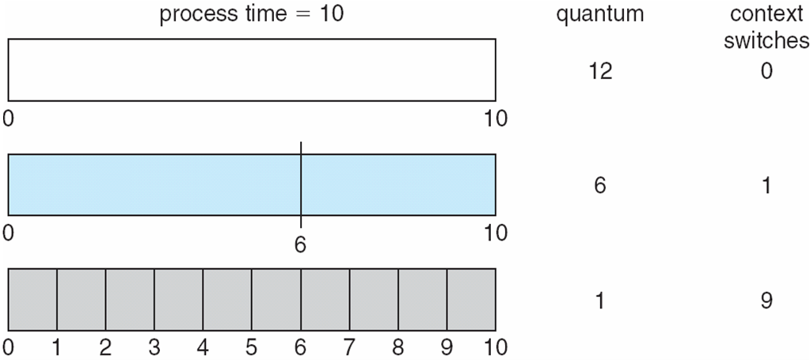
Time Quantum and Context Switch Time

Slide 37
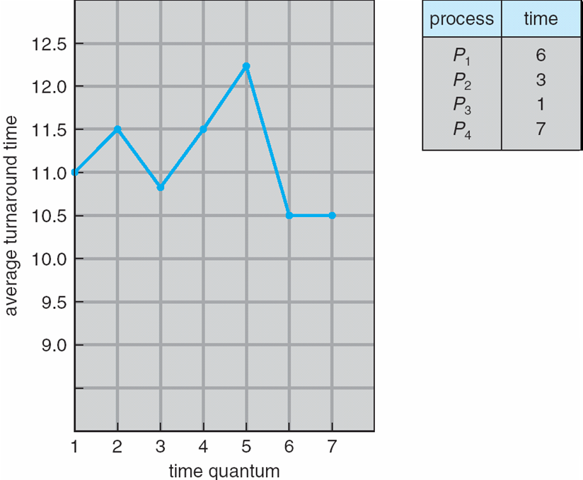
Turnaround Time Varies With The Time Quantum

Slide 38
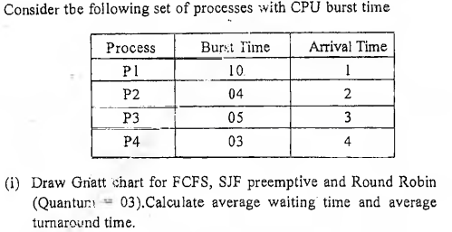
Practice Questions

Slide 39
Practice Questions
10. Consider the following set of processes, with the arrival times and the CPU burst times given in milliseconds.
------------------------------------- Process Arrival-Time Burst-Time ------------------------------------- P1 0 5 P2 1 3 P3 2 3 P4 4 1 ------------------------------------- What is the average turnaround time for these processes with the preemptive shortest remaining processing time first (SROT) algorithm? (a) 5.50 (b) 5.75 (c) 6.00 (d) 6.25

Slide 40
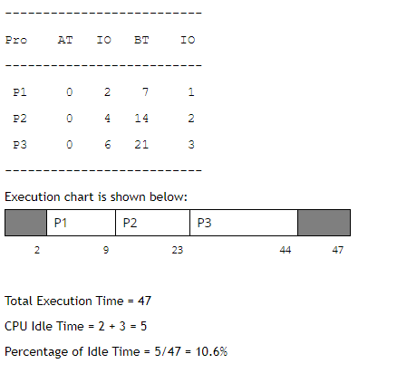
Practice Questions
Consider three processes, all arriving at time zero, with total execution time of 10, 20 and 30 units, respectively. Each process spends the first 20% of execution time doing I/O, the next 70% of time doing computation, and the last 10% of time doing I/O again. The operating system uses a shortest remaining compute time first scheduling algorithm and schedules a new process either when the running process gets blocked on I/O or when the running process finishes its compute burst. Assume that all I/O operations can be overlapped as much as possible. For what percentage of time does the CPU remain idle?
(a) 0% (b) 10.6% (c) 30.0% (d) 89.4%

Slide 41
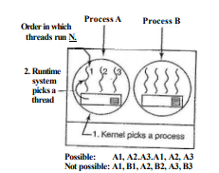
Thread Scheduling
User-level threads
Since the kernel is not aware of the existence of threads, it operates by picking a process, say, A, and giving A control for its quantum.
The thread scheduler inside A decides which thread to run, say Al.
If it uses up the process' entire quantum, the kernel will select another process to run.
This might lead to the sequence Al, A2, A3, Al, A2, A3, Al, A2, A3, Al, before the kernel switches to process B
In practice, round-robin scheduling and priority scheduling are most common for user level thread scheduling.

Slide 42
Thread Scheduling
Kernel-level threads
kernel picks a particular thread to run.
It does not have to take into account which process the thread belongs to, but it can if it wants to.
A major difference between user-level threads and kernel-level threads is the performance.
Doing a thread switch with user-level threads takes a handful of machine instructions. With kernel-level threads it requires a full context switch

Slide 43
End of Chapter 5

